Slide 1
Research Ethics 2
16-4-21
Methods to prevent misconduct

Slide 2
Two slides from the previous class have been added at the end.
Today we are going to discuss about “some methods to prevent unethical practices in research publication”.

Slide 3
1. Peer Review
When the research papers are submitted to the journals for publication, they are not readily accepted. They are subjected to multiple review process. The experts in the subject act as referees. Very often, they are capable of verifying whether there is novelty and originality in that article. They can detect the overlapping with previous published material. They can also easily verify if the conclusions follow from the data or not. They can find out if proper acknowledgements to the previous researchers are deliberately omitted. In short, they can detect many types of misconduct.

Slide 4
2. Improved computing technology.
Day by day, technological devices to detect some kinds of fraud in Research Publication, are increasing.
Here is an instance. If a researcher has deliberately made a digital alteration of results (to suit his or her conclusions), one can ask for the raw data. These data usually contain the date stamp also. It is not difficult to find out at which stage these data have been altered.
Also, the same technology helps the editor or reviewer to ensure that the result is new.

Slide 5

3. Special software
Nowadays there are specifically designed software for detecting specific kinds of fraud.
For instance, verbatim reproduction of an already published result (this is called plagiarism) can be easily detected by such a specific software.
Turnitin is an Internet-based plagiarism detection service run by the US company Turnitin, LLC, a subsidiary of Advance Publications

Slide 6
4. Post-submission verifications
a reviewer can suggest additional experiments
that would further confirm or refute the authors’ claim.
The paper gets rejected if it fails to convince the editorial board during this process of verification.

Slide 7
5. Black listing
Many a time, a fraudulent piece of research passes all the tests and gets published also.
But then it comes under the scrutiny of a larger readership. The fraud gets exposed, though late.
There are post-publication review journals which ruthlessly expose the fraud.
Then the paper gets blacklisted; the authors are blacklisted; the journal itself can be blacklisted. This brings such a disrepute that it serves as a deterrent for a similar fraud by others.

Slide 8
6. Mechanisms to prevent conflict of interest
A long set of guidelines
A legal contract between the author and the publisher.
An undertaking from the authors.
A warning of stringent consequences in case of violation of ethics.
These are some of the existing mechanisms that serve the purpose.

Slide 9
To sum up
Several kinds of misconduct can be prevented.
Some of the methods involve the following:
A peer review system
Technology
Special software
Certain actions between the submission and publication.
Legal precautions
These are pre-publication-steps.

Slide 10
Some others are post-publication-steps:
Critical reviews of published articles.
Black-listing.
Punishment at the institution. (It may even cost one’s job).

Slide 11
1’. More about peer review process
The referees sometimes suggest the following kinds of revision of the paper:
Specific references have to be cited. (They may even give a list).
They provide the details of a previously published paper and suggest that the authors have to revise their paper after going through that.
There are internal inconsistencies that call for corrections or further explanations. Often they clearly describe these inconsistencies. (It may be that the data collected do not tally with the conclusion; or it may be that an argument is invalid).
They point out “mis-representation of others’ works” and “failure to acknowledge some known work”.

Slide 12
2’ More on the use of technology
The advancing technology can be used for the good and the bad.
Just as it can be used to prevent unethical practices in research, it can also be used in generating further unethical practices in research.
In today’s class, we confine to the positive uses of technology.
Here is an instance.
If a researcher has deliberately tampered with the data to draw wrong conclusions, a machine can point out the discrepancy and its location.

Slide 13
3’. More on Software
Agenda :
• Why Turnitin similarity check report. • Instructor Management/ Student Management • Creation of Class and Assignment. • Interpreting of Similarity Reports in Turnitin. • Reviewing student Submission with a similarity report. • Feedback to students. • Similarity Report download.
Webinar on Turnitin

Slide 14
4’ More on Pre-publication-care
The editors provide a checklist to be filled by the authors.
The editors take the consent of all the co-authors.
The pre-reviewers ensure that the arguments are valid.
The specialized proof-readers see that there are no unnecessary repetitions or syntactic mistakes.

Slide 15
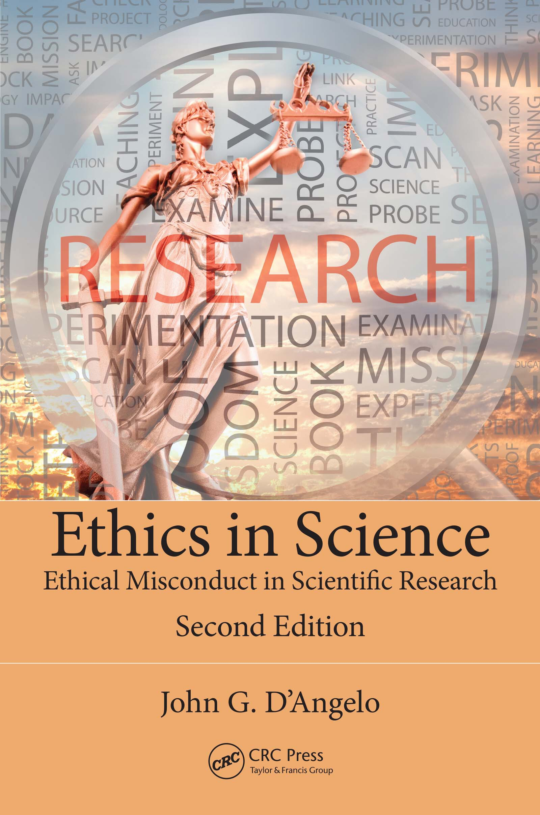

Books followed

Slide 16
10 types of research misconduct
Misappropriation of ideas
Plagiarism
Self-plagiarism
Claiming undeserved authorship
Misuse of research funds
Deceptive generation of preferred results
Falsification of data
Denial of credits to others.
Repeated publication of too similar results.
Mis-representation of others’ results.

